Slide 1
Other Data Sources
Ted Kwartler

Slide 2

Web Scraping
R and other languages let you extract information from websites. This is called “web scraping”.

Slide 3
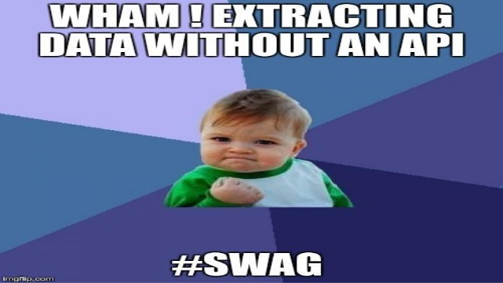
Questionable Practice
Websites don’t like you taking information for various reasons. Always respect terms of service and any blocking software.

Slide 4
Web-scraping
Everything in a webpage is “client” side (interpreted by your computer), therefore you can get anything you see.
Each scrape is literally custom software
Webpages have different styles, object names, and complexity…always check for an API first.

Slide 5
Rvest
R port of python’s “beautiful soup”
Uses %>% to forward html documents
Steps
read_html() to open a “headless” browser and download the html.
Use html_nodes() etc to find locations within the html document.
Once the code navigates to the area of the document, you extract the attribute, text, table there.

Slide 6
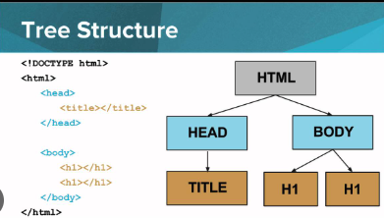
HTML Document Navigation
Cascading Style Sheet:
Named classes used throughout pages
For example: “h1” (header text) should be x font size and color used on all website pages
Xpath:
A language to navigate hierarchical documents like XML and HTML. You can explicitly declare a path to a node in a tree.
https://www.youtube.com/watch?app=desktop&v=90kC1YLNF3U&ab_channel=CodeHS
Image Source

Slide 7
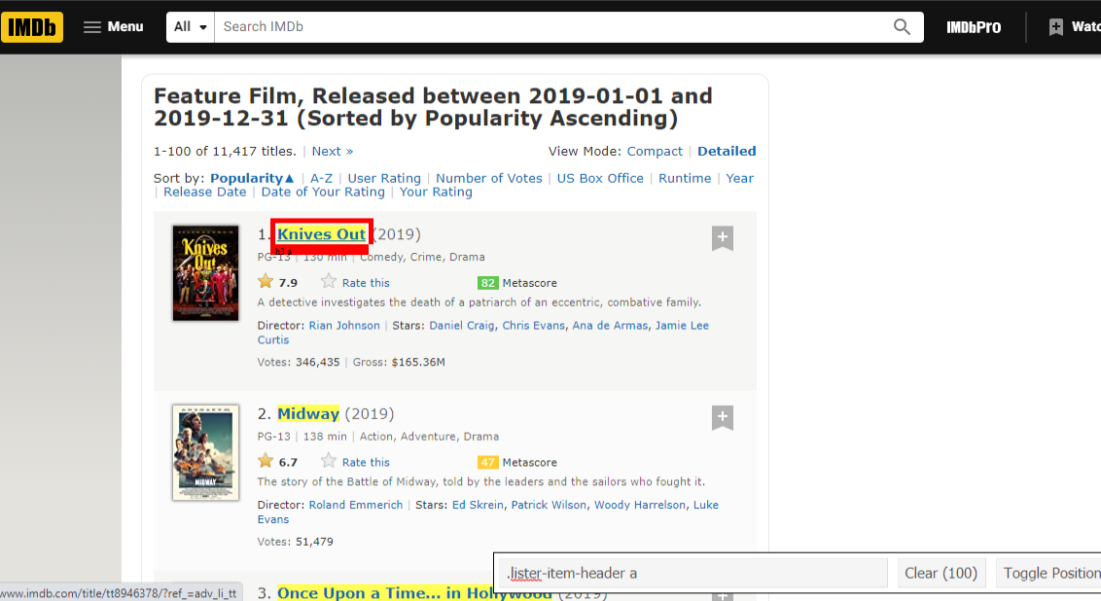
Option: Chrome Add-in “Selector Gadget”
Easy way to identify the CSS class names

Slide 8
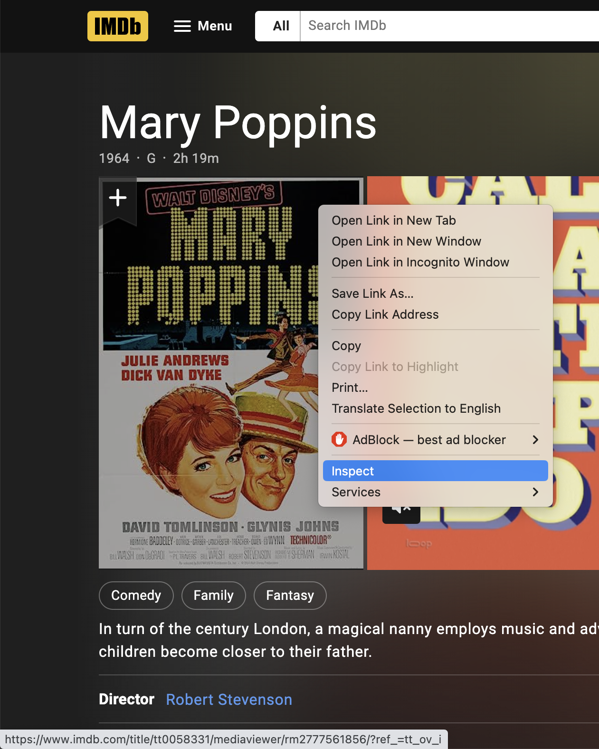
Option: Developer Panel Inspect
Inspect an element

Slide 9
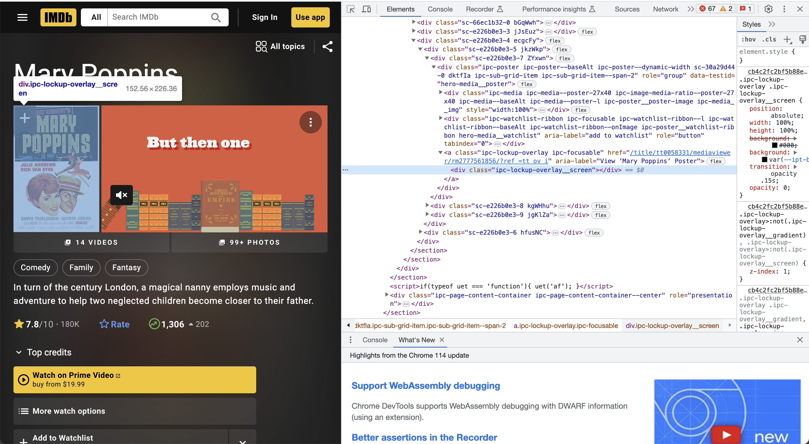
Navigate to the info needed

Slide 10
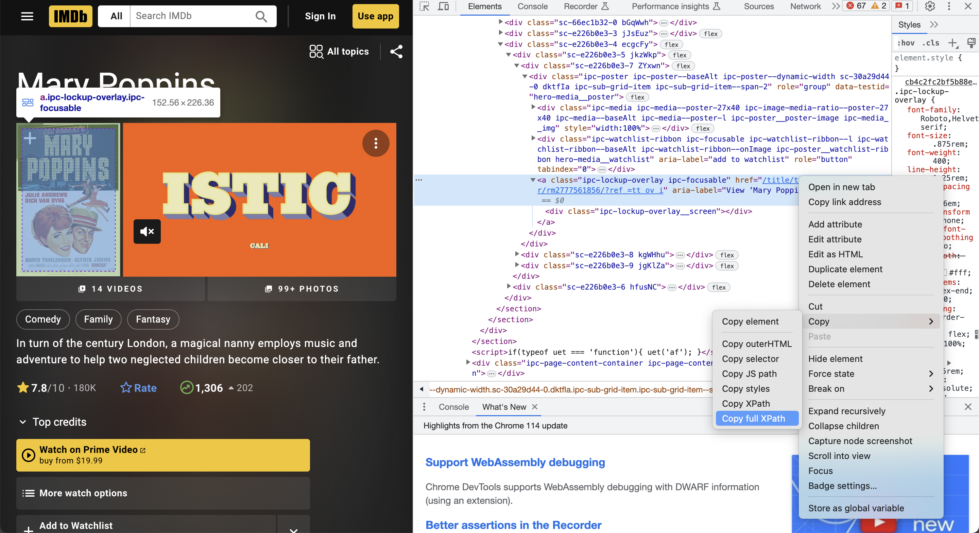
Click Copy>Copy Full Xpath or sometimes Copy>Copy XPath

Slide 11
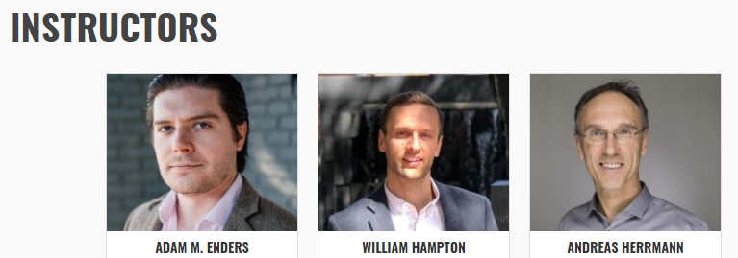
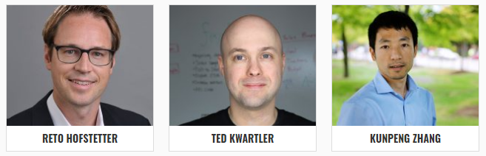
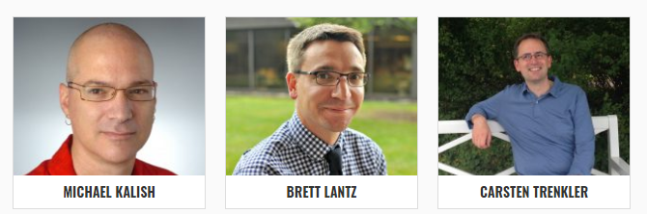
Let’s get the dirt on GSERM’s profs.
Open a “headless” browser to the instructor page. Programatically find all appropriate URLS which is represented by each picture.
…
…

Slide 12
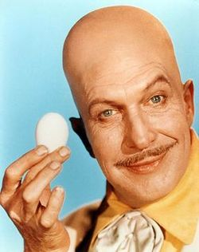
Let’s get the dirt on our profs.
Open a “headless” browser to the instructor page. Find all appropriate URLS which is represented by each picture.
Loop through all ID’ed URLs to get the bio of each professor.
…
…

Slide 13
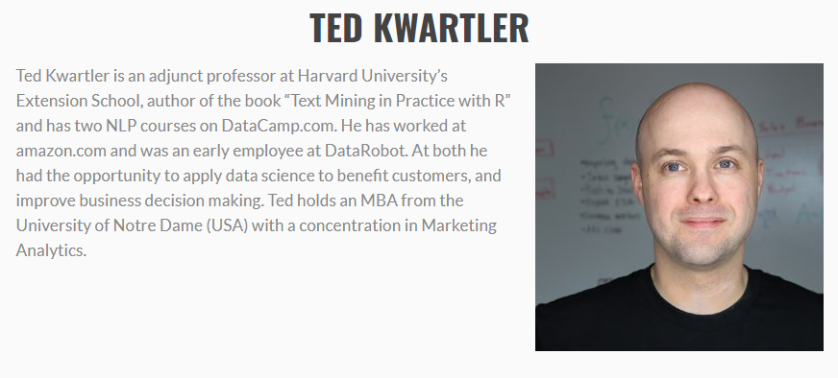
Let’s get the dirt on our profs.
F_webScraping_multipleURLS.R
Open a “headless” browser to the instructor page. Find all appropriate URLS which is represented by each picture.
Loop through all ID’ed URLs to get the bio of each professor.
Extract the bio text from each page and organize

